Slide 1


CSB4202 - DATABASE MANAGEMENT SYSTEMS
B.Tech – III Semester
Dr. A. Antonidoss
Associate professor
School of Computing Sciences,
Department of Computer Science and Engineering

Slide 2
MODULE 3: DATA STORAGE AND QUERY PROCESSING
Record storage and Primary file organization- Secondary storage Devices- Operations on Files- Heap File- Sorted Files- Hashing Techniques – Index Structure for files –Different types of Indexes- B-Tree - B+Tree – Query Processing.

Slide 3
Query Processing
Overview
Measures of Query Cost
Selection Operation
Sorting
Join Operation
Other Operations
Evaluation of Expressions

Slide 4
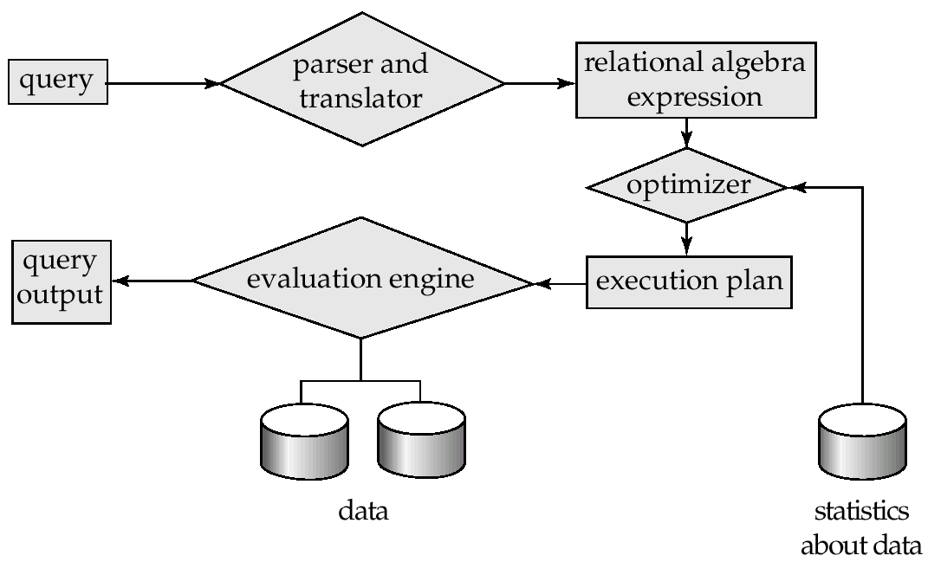
Basic Steps in Query Processing
1. Parsing and translation
2. Optimization
3. Evaluation

Slide 5
Basic Steps in Query Processing (Cont.)
Parsing and translation
translate the query into its internal form. This is then translated into relational algebra.
Parser checks syntax, verifies relations
Evaluation
The query-execution engine takes a query-evaluation plan, executes that plan, and returns the answers to the query.

Slide 6
Basic Steps in Query Processing : Optimization
A relational algebra expression may have many equivalent expressions
E.g., σ_{balance<2500}(∏_{balance}(account)) is equivalent to ∏_{balance}(σ_{balance<2500}(account))
Each relational algebra operation can be evaluated using one of several different algorithms
Correspondingly, a relational-algebra expression can be evaluated in many ways.
Annotated expression specifying detailed evaluation strategy is called an evaluation-plan.
E.g., can use an index on balance to find accounts with balance < 2500,
or can perform complete relation scan and discard accounts with balance ≥ 2500

Slide 7
Basic Steps: Optimization (Cont.)
Query Optimization: Amongst all equivalent evaluation plans choose the one with lowest cost.
Cost is estimated using statistical information from the database catalog
e.g. number of tuples in each relation, size of tuples, etc.
In this chapter we study
How to measure query costs
Algorithms for evaluating relational algebra operations
How to combine algorithms for individual operations in order to evaluate a complete expression
In Chapter 14
We study how to optimize queries, that is, how to find an evaluation plan with lowest estimated cost

Slide 8
Measures of Query Cost
Cost is generally measured as total elapsed time for answering query
Many factors contribute to time cost
disk accesses, CPU, or even network communication
Typically disk access is the predominant cost, and is also relatively easy to estimate. Measured by taking into account
Number of seeks * average-seek-cost
Number of blocks read * average-block-read-cost
Number of blocks written * average-block-write-cost
Cost to write a block is greater than cost to read a block
data is read back after being written to ensure that the write was successful

Slide 9
Measures of Query Cost (Cont.)
For simplicity we just use number of block transfers from disk as the cost measure
We ignore the difference in cost between sequential and random I/O for simplicity
We also ignore CPU costs for simplicity
Costs depends on the size of the buffer in main memory
Having more memory reduces need for disk access
Amount of real memory available to buffer depends on other concurrent OS processes, and hard to determine ahead of actual execution
We often use worst case estimates, assuming only the minimum amount of memory needed for the operation is available
Real systems take CPU cost into account, differentiate between sequential and random I/O, and take buffer size into account
We do not include cost to writing output to disk in our cost formulae

Slide 10
Selection Operation
File scan – search algorithms that locate and retrieve records that fulfill a selection condition.
Algorithm A1 (linear search). Scan each file block and test all records to see whether they satisfy the selection condition.
Cost estimate (number of disk blocks scanned) = b_{r}
b_{r} denotes number of blocks containing records from relation r
If selection is on a key attribute, cost = (b_{r} /2)
stop on finding record
Linear search can be applied regardless of
selection condition or
ordering of records in the file, or
availability of indices

Slide 11
Selection Operation (Cont.)
A2 (binary search). Applicable if selection is an equality comparison on the attribute on which file is ordered.
Assume that the blocks of a relation are stored contiguously
Cost estimate (number of disk blocks to be scanned):
⎡log₂(b_{r})⎤ — cost of locating the first tuple by a binary search on the blocks
Plus number of blocks containing records that satisfy selection condition
Will see how to estimate this cost in Chapter 14

Slide 12
Selections Using Indices
Index scan – search algorithms that use an index
selection condition must be on search-key of index.
A3 (primary index on candidate key, equality). Retrieve a single record that satisfies the corresponding equality condition
Cost = HT_{i} + 1
A4 (primary index on nonkey, equality) Retrieve multiple records.
Records will be on consecutive blocks
Cost = HT_{i} + number of blocks containing retrieved records
A5 (equality on search-key of secondary index).
Retrieve a single record if the search-key is a candidate key
Cost = HT_{i} + 1
Retrieve multiple records if search-key is not a candidate key
Cost = HT_{i} + number of records retrieved
Can be very expensive!
each record may be on a different block
one block access for each retrieved record

Slide 13
Selections Involving Comparisons
Can implement selections of the form σ_{A≤V} (r) or σ_{A ≥ V}(r) by using
a linear file scan or binary search,
or by using indices in the following ways:
A6 (primary index, comparison). (Relation is sorted on A)
For σ_{A ≥ V}(r) use index to find first tuple ≥ v and scan relation sequentially from there
For σ_{A≤V} (r) just scan relation sequentially till first tuple > v; do not use index
A7 (secondary index, comparison).
For σ_{A ≥ V}(r) use index to find first index entry ≥ v and scan index sequentially from there, to find pointers to records.
For σ_{A≤V} (r) just scan leaf pages of index finding pointers to records, till first entry > v
In either case, retrieve records that are pointed to
requires an I/O for each record
Linear file scan may be cheaper if many records are to be fetched!

Slide 14
Implementation of Complex Selections
Conjunction: σ_{θ1}∧ _{θ2}∧. . . _{θn}(r)
A8 (conjunctive selection using one index).
Select a combination of θ_{i} and algorithms A1 through A7 that results in the least cost forσ_{θi} (r).
Test other conditions on tuple after fetching it into memory buffer.
A9 (conjunctive selection using multiple-key index).
Use appropriate composite (multiple-key) index if available.
A10 (conjunctive selection by intersection of identifiers).
Requires indices with record pointers.
Use corresponding index for each condition, and take intersection of all the obtained sets of record pointers.
Then fetch records from file
If some conditions do not have appropriate indices, apply test in memory.

Slide 15
Algorithms for Complex Selections
Disjunction:σ_{θ1}∨ _{θ2} ∨. . . _{θn} (r).
A11 (disjunctive selection by union of identifiers).
Applicable if all conditions have available indices.
Otherwise use linear scan.
Use corresponding index for each condition, and take union of all the obtained sets of record pointers.
Then fetch records from file
Negation: σ_{¬θ}(r)
Use linear scan on file
If very few records satisfy ¬θ, and an index is applicable to θ
Find satisfying records using index and fetch from file

Slide 16
Sorting
We may build an index on the relation, and then use the index to read the relation in sorted order. May lead to one disk block access for each tuple.
For relations that fit in memory, techniques like quicksort can be used. For relations that don’t fit in memory, external sort-merge is a good choice.

Slide 17
External Sort-Merge
Let M denote memory size (in pages).
Create sorted runs. Let i be 0 initially. Repeatedly do the following till the end of the relation: (a) Read M blocks of relation into memory (b) Sort the in-memory blocks (c) Write sorted data to run R_{i}; increment i. Let the final value of I be N
Merge the runs (N-way merge). We assume (for now) that N < M.
Use N blocks of memory to buffer input runs, and 1 block to buffer output. Read the first block of each run into its buffer page
repeat
Select the first record (in sort order) among all buffer pages
Write the record to the output buffer. If the output buffer is full write it to disk.
Delete the record from its input buffer page. If the buffer page becomes empty then read the next block (if any) of the run into the buffer.
until all input buffer pages are empty:

Slide 18
External Sort-Merge (Cont.)
If i ≥ M, several merge passes are required.
In each pass, contiguous groups of M - 1 runs are merged.
A pass reduces the number of runs by a factor of M -1, and creates runs longer by the same factor.
E.g. If M=11, and there are 90 runs, one pass reduces the number of runs to 9, each 10 times the size of the initial runs
Repeated passes are performed till all runs have been merged into one.

Slide 19
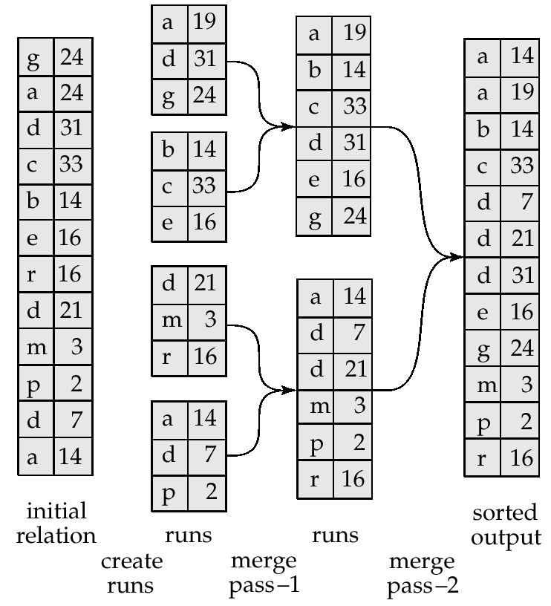
Example: External Sorting Using Sort-Merge

Slide 20
External Merge Sort (Cont.)
Cost analysis:
Total number of merge passes required: ⎡log_{M–1}(b_{r}/M)⎤.
Disk accesses for initial run creation as well as in each pass is 2b_{r}
for final pass, we don’t count write cost
we ignore final write cost for all operations since the output of an operation may be sent to the parent operation without being written to disk
Thus total number of disk accesses for external sorting:
b_{r} ( 2 ⎡log_{M–1}(b_{r} / M)⎤ + 1)

Slide 21
Join Operation
Several different algorithms to implement joins
Nested-loop join
Block nested-loop join
Indexed nested-loop join
Merge-join
Hash-join
Choice based on cost estimate
Examples use the following information
Number of records of customer: 10,000 depositor: 5000
Number of blocks of customer: 400 depositor: 100

Slide 22
Nested-Loop Join
To compute the theta join r _{θ} s for each tuple t_{r} in r do begin for each tuple t_{s} in s do begin test pair (t_{r},t_{s}) to see if they satisfy the join condition θ if they do, add t_{r} • t_{s} to the result. end end
r is called the outer relation and s the inner relation of the join.
Requires no indices and can be used with any kind of join condition.
Expensive since it examines every pair of tuples in the two relations.

Slide 23
Nested-Loop Join (Cont.)
In the worst case, if there is enough memory only to hold one block of each relation, the estimated cost is n_{r} ∗ b_{s} + b_{r} disk accesses.
If the smaller relation fits entirely in memory, use that as the inner relation. Reduces cost to b_{r} + b_{s} disk accesses.
Assuming worst case memory availability cost estimate is
5000 ∗ 400 + 100 = 2,000,100 disk accesses with depositor as outer relation, and
1000 ∗ 100 + 400 = 1,000,400 disk accesses with customer as the outer relation.
If smaller relation (depositor) fits entirely in memory, the cost estimate will be 500 disk accesses.
Block nested-loops algorithm (next slide) is preferable.

Slide 24
Block Nested-Loop Join
Variant of nested-loop join in which every block of inner relation is paired with every block of outer relation.
for each block B_{r} of r do begin for each block B_{s} of s do begin for each tuple t_{r} in B_{r} do begin for each tuple t_{s} in B_{s} do begin Check if (t_{r},t_{s}) satisfy the join condition if they do, add t_{r} • t_{s} to the result. end end end end

Slide 25
Block Nested-Loop Join (Cont.)
Worst case estimate: b_{r} ∗ b_{s} + b_{r} block accesses.
Each block in the inner relation s is read once for each block in the outer relation (instead of once for each tuple in the outer relation
Best case: b_{r} + b_{s} block accesses.
Improvements to nested loop and block nested loop algorithms:
In block nested-loop, use M — 2 disk blocks as blocking unit for outer relations, where M = memory size in blocks; use remaining two blocks to buffer inner relation and output
Cost = ⎡b_{r} / (M-2)⎤ ∗ b_{s} + b_{r}
If equi-join attribute forms a key or inner relation, stop inner loop on first match
Scan inner loop forward and backward alternately, to make use of the blocks remaining in buffer (with LRU replacement)
Use index on inner relation if available (next slide)

Slide 26
Indexed Nested-Loop Join
Index lookups can replace file scans if
join is an equi-join or natural join and
an index is available on the inner relation’s join attribute
Can construct an index just to compute a join.
For each tuple t_{r} in the outer relation r, use the index to look up tuples in s that satisfy the join condition with tuple t_{r}.
Worst case: buffer has space for only one page of r, and, for each tuple in r, we perform an index lookup on s.
Cost of the join: b_{r} + n_{r} ∗ c
Where c is the cost of traversing index and fetching all matching s tuples for one tuple or r
c can be estimated as cost of a single selection on s using the join condition.
If indices are available on join attributes of both r and s, use the relation with fewer tuples as the outer relation.

Slide 27
Example of Nested-Loop Join Costs
Compute depositor customer, with depositor as the outer relation.
Let customer have a primary B⁺-tree index on the join attribute customer-name, which contains 20 entries in each index node.
Since customer has 10,000 tuples, the height of the tree is 4, and one more access is needed to find the actual data
depositor has 5000 tuples
Cost of block nested loops join
400*100 + 100 = 40,100 disk accesses assuming worst case memory (may be significantly less with more memory)
Cost of indexed nested loops join
100 + 5000 * 5 = 25,100 disk accesses.
CPU cost likely to be less than that for block nested loops join

Slide 28
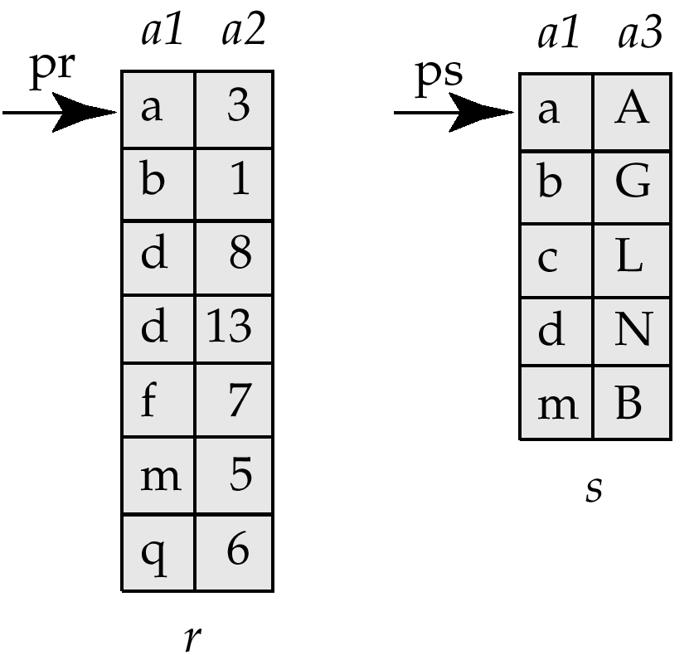
Merge-Join
Sort both relations on their join attribute (if not already sorted on the join attributes).
Merge the sorted relations to join them
Join step is similar to the merge stage of the sort-merge algorithm.
Main difference is handling of duplicate values in join attribute — every pair with same value on join attribute must be matched
Detailed algorithm in book

Slide 29
Merge-Join (Cont.)
Can be used only for equi-joins and natural joins
Each block needs to be read only once (assuming all tuples for any given value of the join attributes fit in memory
Thus number of block accesses for merge-join is b_{r} + b_{s} + the cost of sorting if relations are unsorted.
hybrid merge-join: If one relation is sorted, and the other has a secondary B⁺-tree index on the join attribute
Merge the sorted relation with the leaf entries of the B⁺-tree .
Sort the result on the addresses of the unsorted relation’s tuples
Scan the unsorted relation in physical address order and merge with previous result, to replace addresses by the actual tuples
Sequential scan more efficient than random lookup

Slide 30
Hash-Join
Applicable for equi-joins and natural joins.
A hash function h is used to partition tuples of both relations
h maps JoinAttrs values to {0, 1, ..., n}, where JoinAttrs denotes the common attributes of r and s used in the natural join.
r₀, r₁, . . ., r_{n} denote partitions of r tuples
Each tuple t_{r} ∈ r is put in partition r_{i} where i = h(t_{r} [JoinAttrs]).
r₀,, r₁. . ., r_{n} denotes partitions of s tuples
Each tuple t_{s} ∈s is put in partition s_{i}, where i = h(t_{s} [JoinAttrs]).
Note: In book, r_{i} is denoted as H_{ri,} s_{i} is denoted as H_{si} and n is denoted as n_{h.}

Slide 31
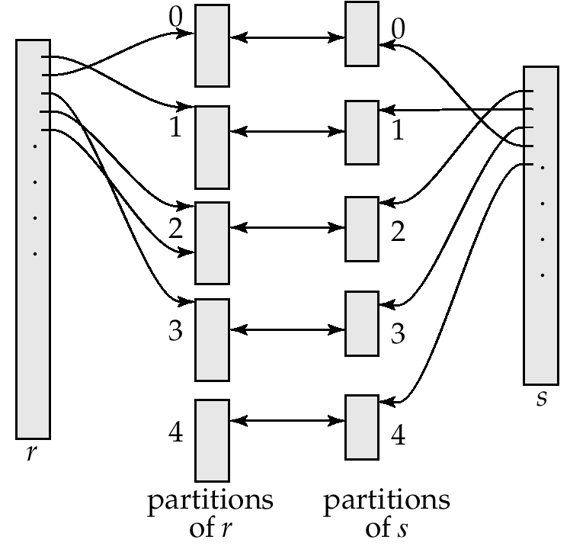
Hash-Join (Cont.)

Slide 32
Hash-Join (Cont.)
r tuples in r_{i} need only to be compared with s tuples in s_{i} Need not be compared with s tuples in any other partition, since:
an r tuple and an s tuple that satisfy the join condition will have the same value for the join attributes.
If that value is hashed to some value i, the r tuple has to be in r_{i} and the s tuple in s_{i}.

Slide 33
Hash-Join Algorithm
The hash-join of r and s is computed as follows.
1.Partition the relation s using hashing function h. When partitioning a relation, one block of memory is reserved as the output buffer for each partition.
2.Partition r similarly.
3. For each i:
(a) Load s_{i} into memory and build an in-memory hash index on it using the join attribute. This hash index uses a different hash function than the earlier one h.
(b) Read the tuples in r_{i} from the disk one by one. For each tuple t_{r} locate each matching tuple t_{s} in s_{i} using the in-memory hash index. Output the concatenation of their attributes.
Relation s is called the build input and r is called the probe input.

Slide 34
Hash-Join algorithm (Cont.)
The value n and the hash function h is chosen such that each s_{i} should fit in memory.
Typically n is chosen as ⎡b_{s}/M⎤ * f where f is a “fudge factor”, typically around 1.2
The probe relation partitions s_{i} need not fit in memory
Recursive partitioning required if number of partitions n is greater than number of pages M of memory.
instead of partitioning n ways, use M – 1 partitions for s
Further partition the M – 1 partitions using a different hash function
Use same partitioning method on r
Rarely required: e.g., recursive partitioning not needed for relations of 1GB or less with memory size of 2MB, with block size of 4KB.

Slide 35
Handling of Overflows
Hash-table overflow occurs in partition s_{i} if s_{i} does not fit in memory. Reasons could be
Many tuples in s with same value for join attributes
Bad hash function
Partitioning is said to be skewed if some partitions have significantly more tuples than some others
Overflow resolution can be done in build phase
Partition s_{i} is further partitioned using different hash function.
Partition r_{i} must be similarly partitioned.
Overflow avoidance performs partitioning carefully to avoid overflows during build phase
E.g. partition build relation into many partitions, then combine them
Both approaches fail with large numbers of duplicates
Fallback option: use block nested loops join on overflowed partitions

Slide 36
Cost of Hash-Join
If recursive partitioning is not required: cost of hash join is 3(b_{r} + b_{s}) +2 ∗ n_{h}
If recursive partitioning required, number of passes required for partitioning s is ⎡log_{M–1}(b_{s}) – 1⎤. This is because each final partition of s should fit in memory.
The number of partitions of probe relation r is the same as that for build relation s; the number of passes for partitioning of r is also the same as for s.
Therefore it is best to choose the smaller relation as the build relation.
Total cost estimate is:
2(b_{r} + b_{s} ⎡log_{M–1}(b_{s}) – 1⎤ + b_{r} + b_{s}
If the entire build input can be kept in main memory, n can be set to 0 and the algorithm does not partition the relations into temporary files. Cost estimate goes down to b_{r} + b_{s}.

Slide 37
Example of Cost of Hash-Join
customer depositor
Assume that memory size is 20 blocks
b_{depositor}= 100 and b_{customer} = 400.
depositor is to be used as build input. Partition it into five partitions, each of size 20 blocks. This partitioning can be done in one pass.
Similarly, partition customer into five partitions,each of size 80. This is also done in one pass.
Therefore total cost: 3(100 + 400) = 1500 block transfers
ignores cost of writing partially filled blocks

Slide 38
Hybrid Hash–Join
Useful when memory sized are relatively large, and the build input is bigger than memory.
Main feature of hybrid hash join:
Keep the first partition of the build relation in memory.
E.g. With memory size of 25 blocks, depositor can be partitioned into five partitions, each of size 20 blocks.
Division of memory:
The first partition occupies 20 blocks of memory
1 block is used for input, and 1 block each for buffering the other 4 partitions.
customer is similarly partitioned into five partitions each of size 80; the first is used right away for probing, instead of being written out and read back.
Cost of 3(80 + 320) + 20 +80 = 1300 block transfers for hybrid hash join, instead of 1500 with plain hash-join.
Hybrid hash-join most useful if M >>

Slide 39
Complex Joins
Join with a conjunctive condition:
r _{θ1∧ θ 2∧... ∧ θ n} s
Either use nested loops/block nested loops, or
Compute the result of one of the simpler joins r _{θi} s
final result comprises those tuples in the intermediate result that satisfy the remaining conditions
θ₁ ∧ . . . ∧ θ_{i –1} ∧ θ_{i +1} ∧ . . . ∧ θ_{n}
Join with a disjunctive condition
r _{θ1 ∨ θ2 ∨... ∨ θn} s
Either use nested loops/block nested loops, or
Compute as the union of the records in individual joins r _{θ i} s:
(r _{θ1} s) ∪ (r _{θ2} s) ∪ . . . ∪ (r _{θn} s)

Slide 40
Other Operations
Duplicate elimination can be implemented via hashing or sorting.
On sorting duplicates will come adjacent to each other, and all but one set of duplicates can be deleted. Optimization: duplicates can be deleted during run generation as well as at intermediate merge steps in external sort-merge.
Hashing is similar – duplicates will come into the same bucket.
Projection is implemented by performing projection on each tuple followed by duplicate elimination.

Slide 41
Other Operations : Aggregation
Aggregation can be implemented in a manner similar to duplicate elimination.
Sorting or hashing can be used to bring tuples in the same group together, and then the aggregate functions can be applied on each group.
Optimization: combine tuples in the same group during run generation and intermediate merges, by computing partial aggregate values
For count, min, max, sum: keep aggregate values on tuples found so far in the group.
When combining partial aggregate for count, add up the aggregates
For avg, keep sum and count, and divide sum by count at the end

Slide 42
Other Operations : Set Operations
Set operations (∪, ∩ and ⎯): can either use variant of merge-join after sorting, or variant of hash-join.
E.g., Set operations using hashing:
1. Partition both relations using the same hash function, thereby creating, r_{1, ..,} r_{n} r_{0,} and s_{1,} s_{2..,} s_{n}
2. Process each partition i as follows. Using a different hashing function, build an in-memory hash index on r_{i} after it is brought into memory.
3. – r ∪ s: Add tuples in s_{i} to the hash index if they are not already in it. At end of s_{i} add the tuples in the hash index to the result.
– r ∩ s: output tuples in s_{i} to the result if they are already there in the hash index.
– r – s: for each tuple in s_{i}, if it is there in the hash index, delete it from the index. At end of s_{i} add remaining tuples in the hash index to the result.

Slide 43
Other Operations : Outer Join
Outer join can be computed either as
A join followed by addition of null-padded non-participating tuples.
by modifying the join algorithms.
Modifying merge join to compute r s
In r s, non participating tuples are those in r – Π_{R}(r s)
Modify merge-join to compute r s: During merging, for every tuple t_{r} from r that do not match any tuple in s, output t_{r} padded with nulls.
Right outer-join and full outer-join can be computed similarly.
Modifying hash join to compute r s
If r is probe relation, output non-matching r tuples padded with nulls
If r is build relation, when probing keep track of which r tuples matched s tuples. At end of s_{i} output non-matched r tuples padded with nulls

Slide 44
Evaluation of Expressions
So far: we have seen algorithms for individual operations
Alternatives for evaluating an entire expression tree
Materialization: generate results of an expression whose inputs are relations or are already computed, materialize (store) it on disk. Repeat.
Pipelining: pass on tuples to parent operations even as an operation is being executed
We study above alternatives in more detail

Slide 45
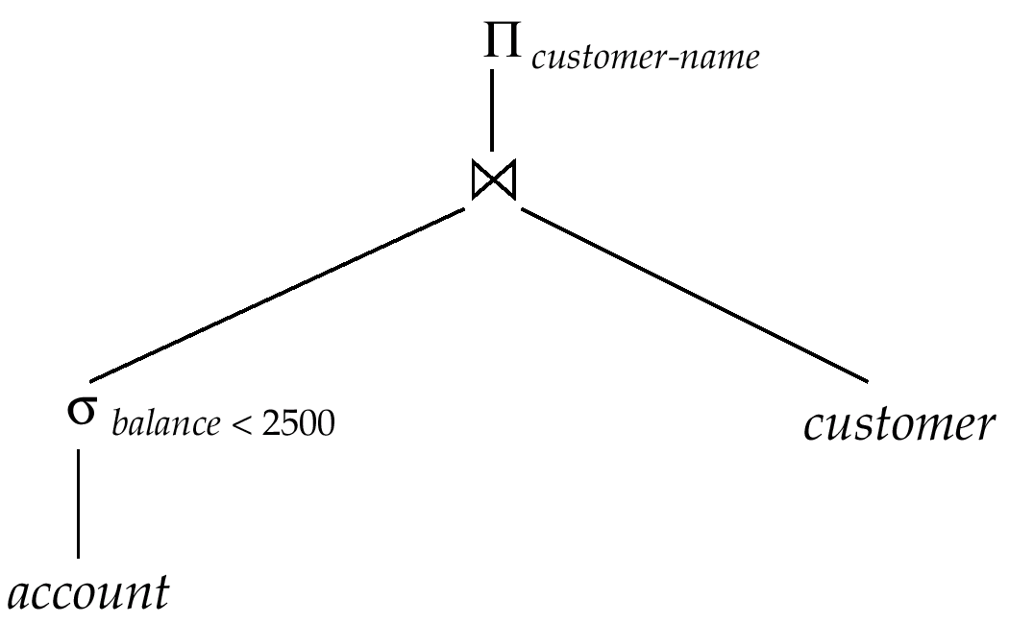
Materialization
Materialized evaluation: evaluate one operation at a time, starting at the lowest-level. Use intermediate results materialized into temporary relations to evaluate next-level operations.
E.g., in figure below, compute and store then compute the store its join with customer, and finally compute the projections on customer-name.

Slide 46
Materialization (Cont.)
Materialized evaluation is always applicable
Cost of writing results to disk and reading them back can be quite high
Our cost formulas for operations ignore cost of writing results to disk, so
Overall cost = Sum of costs of individual operations + cost of writing intermediate results to disk
Double buffering: use two output buffers for each operation, when one is full write it to disk while the other is getting filled
Allows overlap of disk writes with computation and reduces execution time

Slide 47
Pipelining
Pipelined evaluation : evaluate several operations simultaneously, passing the results of one operation on to the next.
E.g., in previous expression tree, don’t store result of
instead, pass tuples directly to the join.. Similarly, don’t store result of join, pass tuples directly to projection.
Much cheaper than materialization: no need to store a temporary relation to disk.
Pipelining may not always be possible – e.g., sort, hash-join.
For pipelining to be effective, use evaluation algorithms that generate output tuples even as tuples are received for inputs to the operation.
Pipelines can be executed in two ways: demand driven and producer driven

Slide 48
Pipelining (Cont.)
In demand driven or lazy evaluation
system repeatedly requests next tuple from top level operation
Each operation requests next tuple from children operations as required, in order to output its next tuple
In between calls, operation has to maintain “state” so it knows what to return next
Each operation is implemented as an iterator implementing the following operations
open()
E.g. file scan: initialize file scan, store pointer to beginning of file as state
E.g.merge join: sort relations and store pointers to beginning of sorted relations as state
next()
E.g. for file scan: Output next tuple, and advance and store file pointer
E.g. for merge join: continue with merge from earlier state till next output tuple is found. Save pointers as iterator state.
close()

Slide 49
Pipelining (Cont.)
In produce-driven or eager pipelining
Operators produce tuples eagerly and pass them up to their parents
Buffer maintained between operators, child puts tuples in buffer, parent removes tuples from buffer
if buffer is full, child waits till there is space in the buffer, and then generates more tuples
System schedules operations that have space in output buffer and can process more input tuples

Slide 50
Evaluation Algorithms for Pipelining
Some algorithms are not able to output results even as they get input tuples
E.g. merge join, or hash join
These result in intermediate results being written to disk and then read back always
Algorithm variants are possible to generate (at least some) results on the fly, as input tuples are read in
E.g. hybrid hash join generates output tuples even as probe relation tuples in the in-memory partition (partition 0) are read in
Pipelined join technique: Hybrid hash join, modified to buffer partition 0 tuples of both relations in-memory, reading them as they become available, and output results of any matches between partition 0 tuples
When a new r₀ tuple is found, match it with existing s₀ tuples, output matches, and save it in r₀
Symmetrically for s₀ tuples

Slide 51
Complex Joins
Join involving three relations: loan depositor customer
Strategy 1. Compute depositor customer; use result to compute loan (depositor customer)
Strategy 2. Computer loan depositor first, and then join the result with customer.
Strategy 3. Perform the pair of joins at once. Build and index on loan for loan-number, and on customer for customer-name.
For each tuple t in depositor, look up the corresponding tuples in customer and the corresponding tuples in loan.
Each tuple of deposit is examined exactly once.
Strategy 3 combines two operations into one special-purpose operation that is more efficient than implementing two joins of two relations.

Slide 52
Summary
Overview
Measures of Query Cost
Selection Operation
Sorting
Join Operation
Other Operations
Evaluation of Expressions

Slide 53
Quiz
Which of the following schemas does define a view or views of the database for particular users? a) Internal schema b) Conceptual schema c) Physical schema d) External schema

Slide 54
Quiz
Which of the following schemas does define a view or views of the database for particular users? a) Internal schema b) Conceptual schema c) Physical schema d) External schema
Answer d

Slide 55


Slide 56
The End

